Slide 1
ASSET MANAGEMENT What we do
Infrastructure Committee
9 May 2023

Slide 2
Who are Asset Management?
Brisbane Infrastructure
Divisional Manager
Scott Stewart
City Projects Office
City Standards
Transport Planning & Operations
Asset Management
General Manager
Joe Bannan
Asset Management, Projects and Innovation
Darryl Airlie
Asset Portfolio Management
Tristan Hughes
Strategic Asset Management
Mark Fallon
Asset Information Management
Jodie Hubbard
Many areas of Council have a role in Council’s Asset Management System.
Asset Management (AM) is the branch responsible for facilitating the strategic asset management of Council’s built and natural assets to maximise their value to the community in line with the Council's 2031 Brisbane Vision.
The Branch is responsible for the Strategic Asset Management of roads, stormwater, waterways, buildings, park, property and duct and fiber.
AM’s role is to lead the governance, investigation, evaluation and recommendations for asset related issues.

Slide 3
Asset Management Branch: Functions and Priorities
Economics
Model long term asset investment
Digital Information
Asset data, registers and system management
Reporting
Property Portfolio
Manage Council’s corporate real estate portfolio
Governance
Engineering and Sustainability
Infrastructure standard custodian
Calculate remaining useful life of assets
Asset research and innovation (inc. research into recycled materials into our assets)
Set asset policy and practice standards
Coordinate asset management plan development
Digital Engineering and data improvements
Revaluation of Council Assets
Manage Owner’s consent process for parks, open land, road corridor and vacant land
Asset risk management
Manage public and private sector partnerships, agreements, leases and contracts
Lead Asset Steering Committee
Automated Data Capture
Support condition inspection – tools and process​
Manage Contributed Assets
Council lease management
Property asset renewal planning
Condition, fire & safety and asbestos assessments​
Accommodation contracts​
City Parking – Off-street parking management
Lead asset class preservation planning
Coordinate Council input for State Led Projects

Slide 4
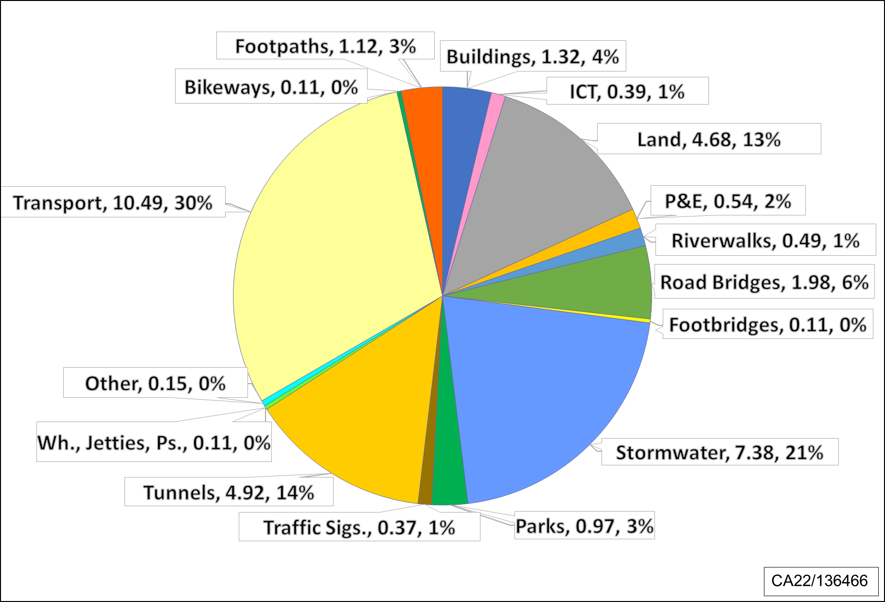
Council Assets Value ~$35 billion
Source: Gross Replacement Values - BCC, 30 June 2022

Slide 5
Asset Management in Council – Council Assets
Asset Category | Asset Sub-Class | Quantities
BRIDGES | Cross River Bridges | 8 | bridges
 | Road Bridges | 201 | bridges
 | Pedestrian Bridges | 736 | bridges
 | Culverts | 2335 | culverts
BUILDINGS (Community) | Entertainment Venues | 11 | venues
 | Community Halls | 25 | halls
 | Commercial Car Parks | 2 | buildings
 | Libraries | 33 | libraries
 | City Hall | 1
BUILDINGS (Corporate) | Asphalt Plants | 2 | sites
 | Cemeteries & Crematoria | 12 | sites
 | Offices, Workshops & Works & Bus Depots, Ward Offices | 88 | sites
 | Other Buildings | 32 | sites
 | Quarries | 3 | sites
RECREATION FACILITIES | Pools | 22 | sites
 | Sports or Community Leases | 757 | sites
Asset Category | Asset Sub-Class | Quantities
ROAD AND TRANSPORT NETWORK | Road Pavement | 5,761 | km
 | Footpaths | 4,933 | km
 | River walk | 5.7 | km
 | Street Lighting (council owned (15,506) & Energex owned) | 129,784 | lights
 | Bus Stops | 5,699 | sites
 | Ferry Terminals | 27 | terminals
 | Kerb and Channel & Medians | 10,637 | km
 | Retaining Walls | 136,827 | sqm
 | Traffic Signals | 1007 | signals
 | Parking Meters | 883 | meters
STORMWATER DRAINAGE NETWORK | Waterway | 2,877 | km
 | Enclosed Drainage | ~4,000 | km
PARKS AND STREETSCAPES | Parks | 2187 | sites
 | Playgrounds | 1072 | nodes
 | Picnic Facilities | 605 | nodes
 | Open Space Buildings | 273 | buildings
 | Monuments & Memorials | 314 | pieces
Source: BCC Systems Data as at 30/06/2022 and Asset Management Plans 2022.

Slide 6
Managing Council Assets - Principles
Oversight and leadership.
Asset related responsibilities are clear.
Consider whole of life funding for new assets.
Ageing is natural and can be responsibly managed in all assets.
Every asset will need maintenance.
Sustainably plan maintenance and renewal investment.

Slide 7
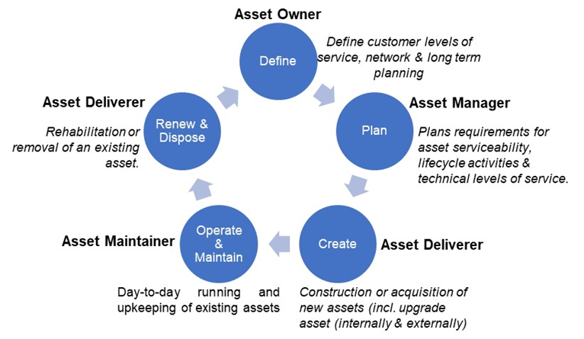
Managing Council Assets - Roles
Asset Steering Committee Oversight
Staff Roles and Responsibilities

Slide 8
Branch Recent Achievements and Upcoming Initiatives
Off-street Carpark Modernisation
Brisbane Metro -depot management planning and preparation
Long Term Asset Management Plan
Asset Management Model revision
Asphalt Innovation Committee
Expanding innovation programs to cover all asset classes and recycled materials
Asset Registration milestone
Digital Asset Data and BIM

Slide 9
Councillors as a Custodian (example):
Council land use governance
What: Applications in relation to the use of Council owned and Council controlled land.
Why: Ensure the most effective use of and minimal impact to the land, facilitating sustainable development across the city.
Types of applications which are sent to Councillors for input include:
Owner’s consent for applications under the Planning Act and Qld Heritage Act and as required by other types of legislation.
Permanent road closures, simultaneous road opening and closure of a road, permits to occupy and road licences.
Easement applications including granting of and acceptance of for requests for new infrastructure including water, sewer, power and gas.
Requests from the Queensland Government for Council’s views on their applications e.g. term lease renewals.

Slide 10
Questions

